Slide 1
BIOERA is a leading project management and consultancy firm headquartered in Riyadh, Saudi Arabia, serving the Gulf Cooperation Council (GCC) region.

Slide 2
ABOUT US
In today’s globalized world, having the right partners is essential for successful business execution and completion.
As a leading Saudi project management company, BIOERA has become the preferred intermediary for top international strategic partners in the engineering and project solutions sectors for life sciences and advanced technology industries that offer turnkey modular facility solutions and off-site pharmaceutical plant manufacturing worldwide.

Slide 3
Our Services

Slide 4
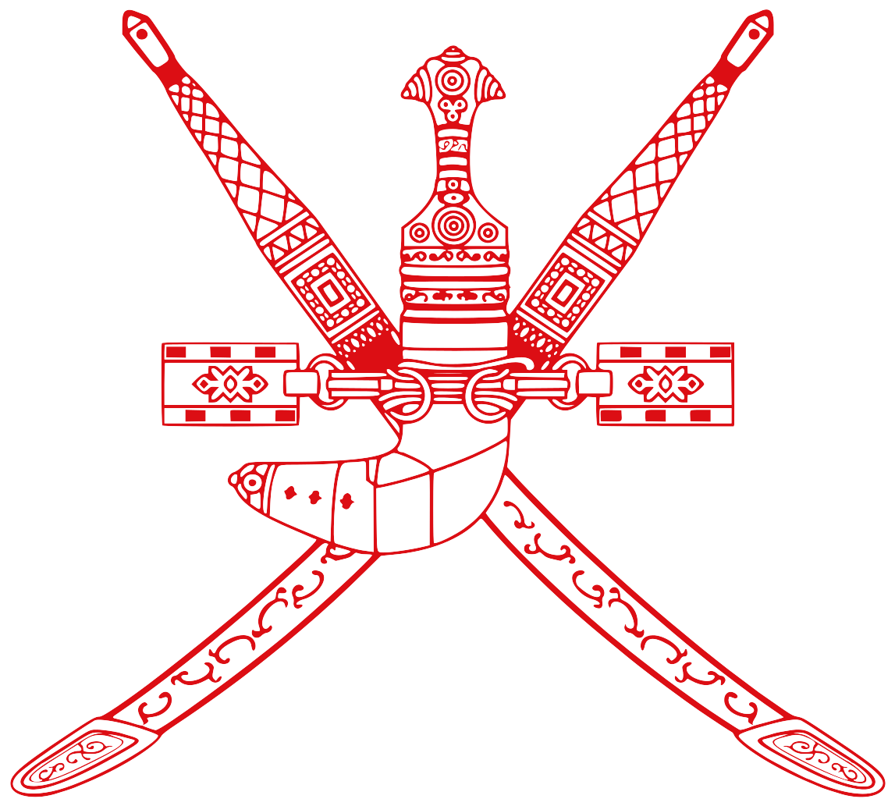
Serving the GCC Region

Slide 5
OUR STRATEGIC PARTNERS

Slide 6
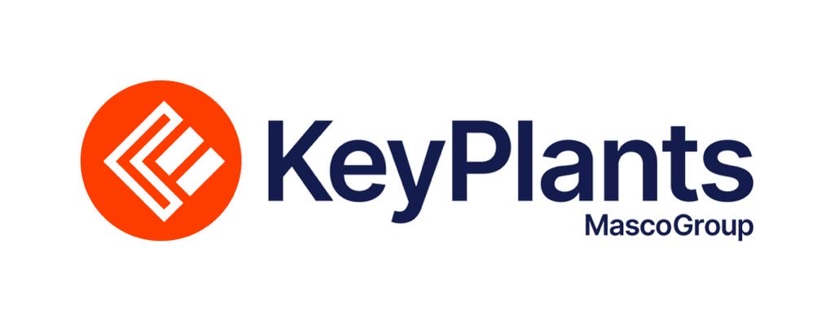
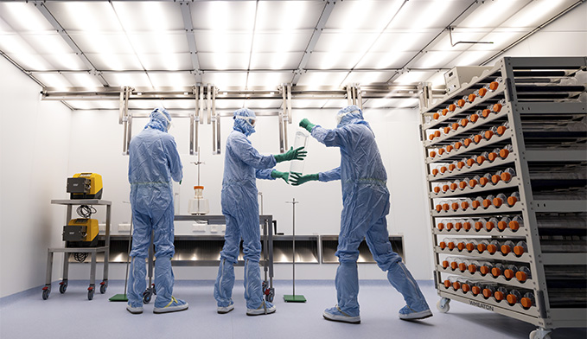
KeyPlants
Sweden-based KeyPlants, a division of the German Dorsche Group, offers comprehensive engineering consulting services.
The company specializes in prefabricated plant design, construction, project management, and facility development for factories, R&D centers, and innovation hubs.
With expertise in the life sciences and advanced technology sectors, KeyPlants has successfully executed over 220 global industrial projects for leading companies, including AstraZeneca, MSD, Eli Lilly, GSK, Teva, Galderma, and Saudi Bio, ensuring world-class solutions across the biopharmaceutical and life sciences industries.

Slide 7
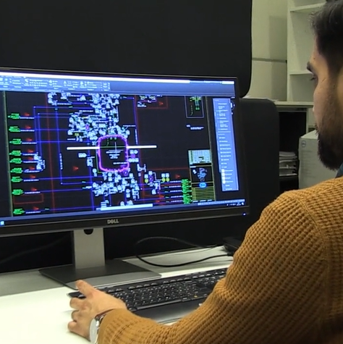
A Landmark Achievement
Specialized Expertise
Over 220 Projects
KeyPlants specializes in prefabricated plant design and construction, project management, and facility design for factories, R&D, and innovation centers
KeyPlants has successfully managed and executed over 220 industrial projects globally
Leading Clients
Global Presence
KeyPlants has delivered world-class solutions for leading companies such as AstraZeneca, MSD, Eli Lilly, GSK, Teva, Galderma, and Saudi Bio
As a sister company of the German Dorsche Group, KeyPlants is a global company based in Sweden with a proven track record worldwide

Slide 8
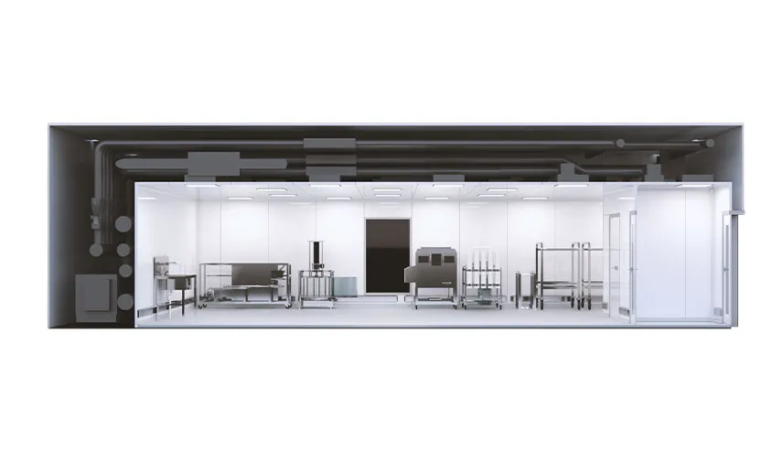
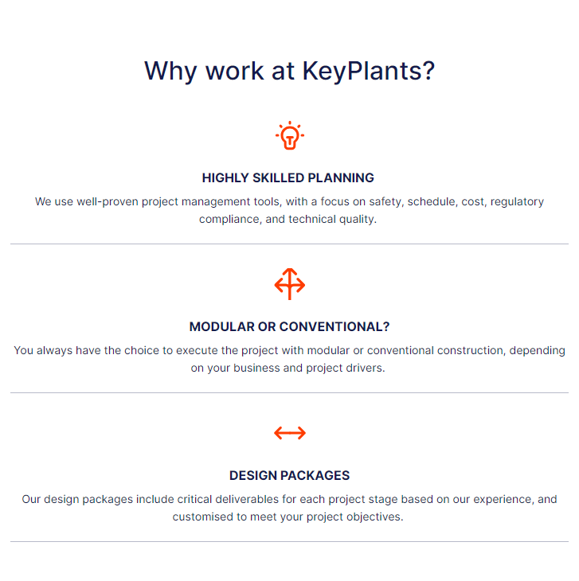
KeyPlants Services
Modular solutions:
Modular and Podular solutions lower cost and risk, while increasing quality, safety and speed
Design & Engineering:
Build, renovate or expand,
efficiently and sustainably.
Consulting Services:
Specialist consultants work
across the life sciences industry, including:
Pharma
Biotech
MedTech

Slide 9
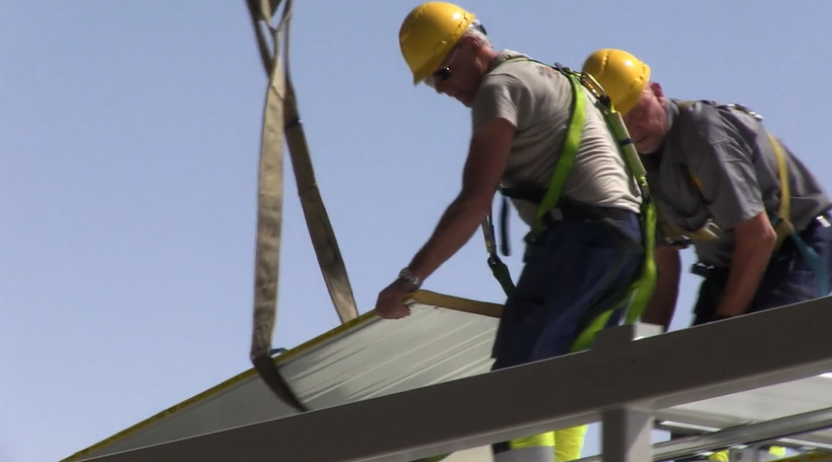
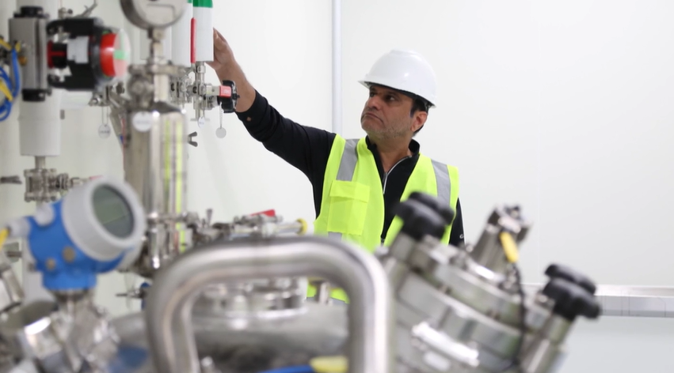
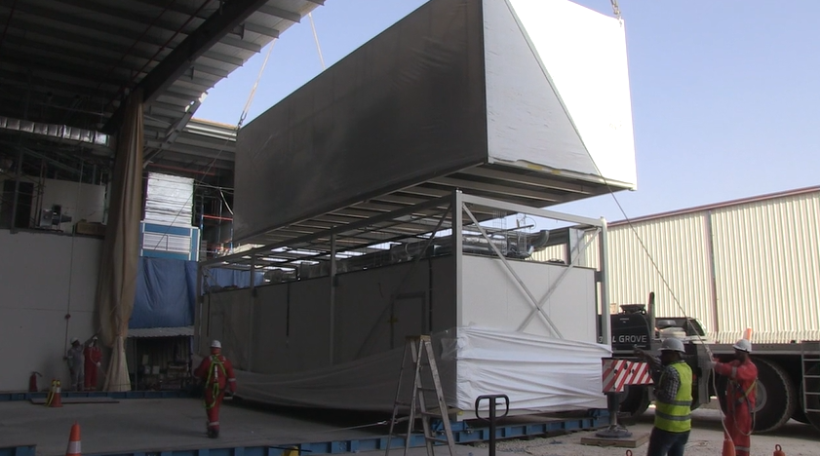
SAUDIBIO JOURNEY
A Landmark Achievement of KeyPlants in the GCC

Slide 10
Zyme Biotech is global project management consultancy dedicated to advancing biotechnology while working alongside premier biotech companies to launch new products, achieve operational success, and accelerate scientific breakthroughs.
With over a decade of specialized experience, Zyme Biotech has become an essential partner for top biotech firms, offering strategic insights and robust solutions that drive growth and innovation.
More than just consultants, Zyme Biotech serves as innovation partners, delivering cutting-edge solutions throughout the entire biotech journey—from research and development to commercialization.

Slide 11
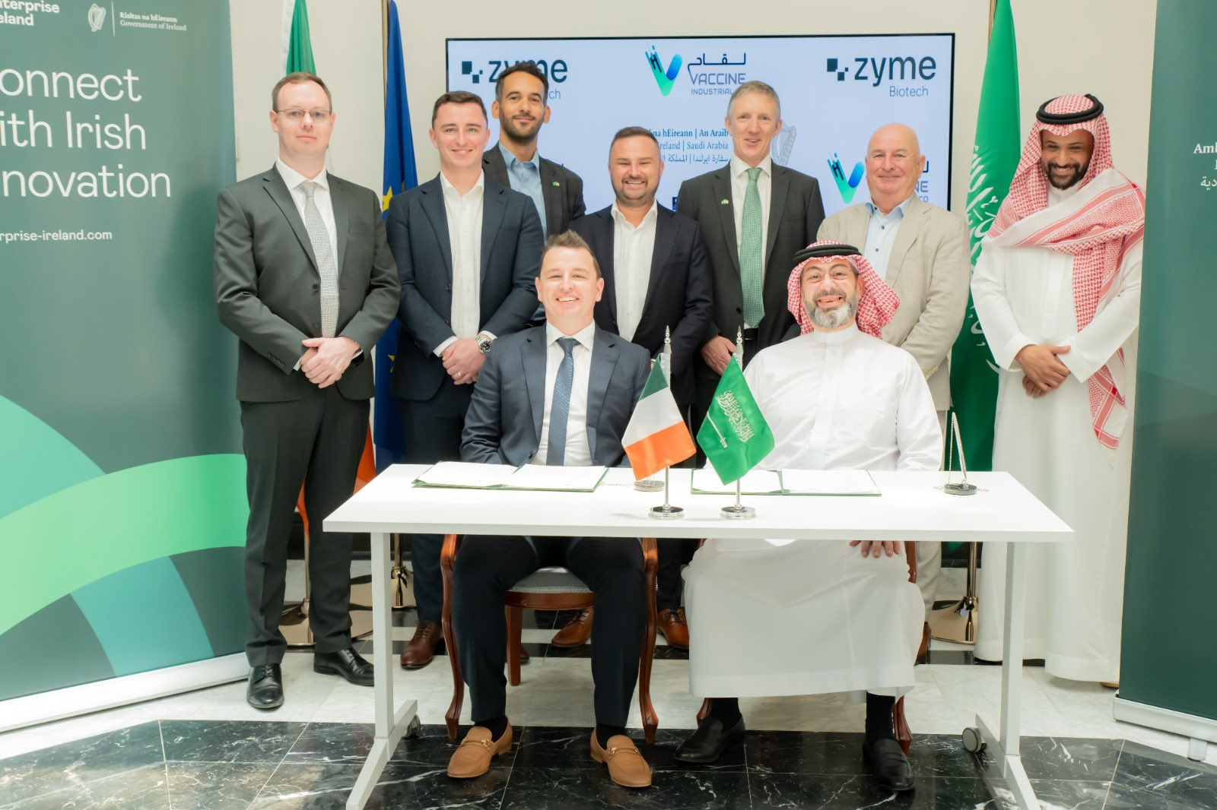
Embracing the ambitious goals of Saudi Vision 2030, Zyme Biotech proudly partnered with the Vaccine Industries Company (VIC), the premier vaccine manufacturer in the Middle East.
The event was honored by the presence of His Excellency, the Irish Ambassador, along with representatives from the Irish Government, marking a significant milestone in our commitment to advancing health innovation

Slide 12
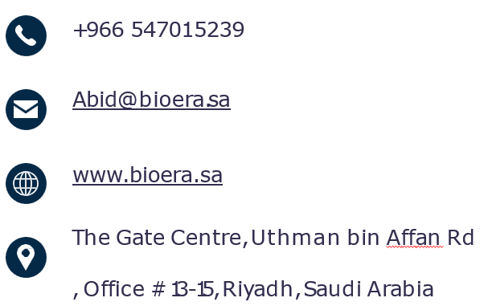
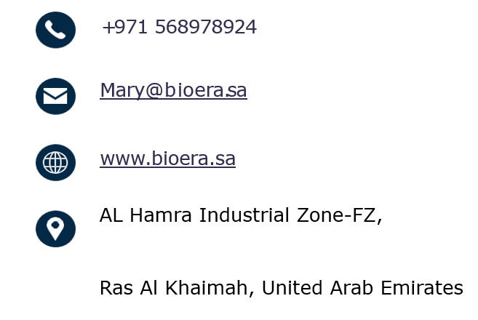
Let’s Get in Touch
Abid Ali
Business Development Manager - KSA
Mary Joy
Business Development Manager - UAE

